Slide 1
poultry diseases fourth stage
Ascites, mycotoxicosis, and fatty liver and kidney syndrome
Dr. Isam Azeez
Department of Pathology and Poultry Disease
College of Veterinary Medicine university of Basrah

Slide 2
Ascites
Ascites is a pathological condition that is usually related to the accumulation of body fluid, especially in the abdominal cavity of chickens. This fluid is composed of lymph and blood plasma and is caused by the body’s inability to supply the required oxygen demand (hypoxia).
Ascites are avian ascites, water belly, avian edema, and pulmonary hypertension syndrome. It is common with broilers and older laying hens.

Slide 3
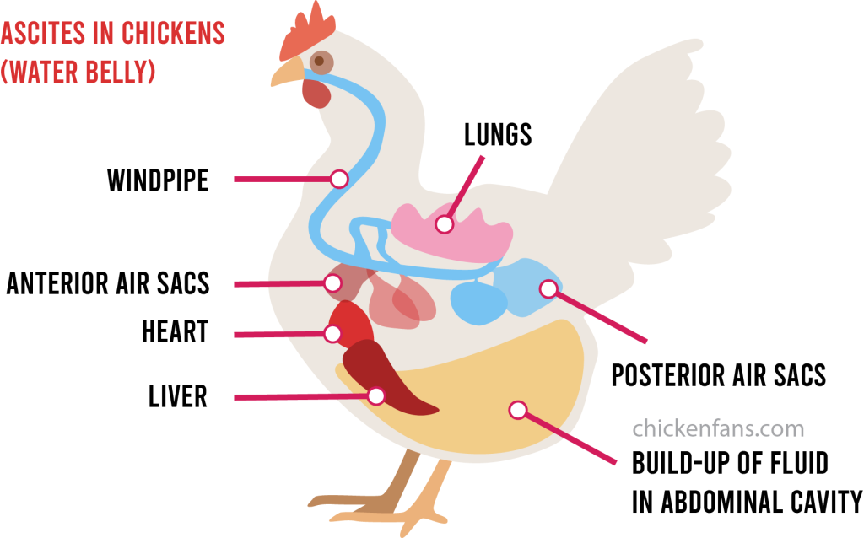
Causes
Interactions between management, environment, infection agent and genetic factors play a significant role in developing this disease.

Slide 4
Clinical signs
Affected birds may have abdominal distension caused by accumulation of ascitic fluid

Slide 5
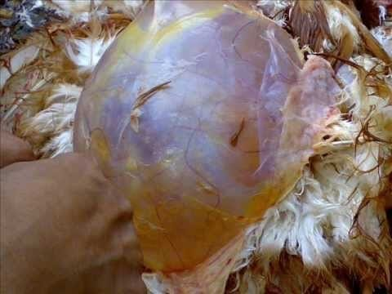
Ascites
Broiler chicken with abdomen distended with fluid secondary to right ventricular heart failure.

Slide 6
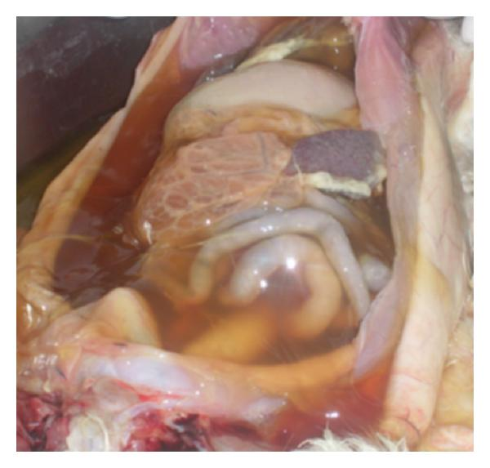
Ascites
The ascitic fluid is straw‐yellow colored with or without fibrin clots

Slide 7
Mycotoxicosis
Aflatoxins are highly toxic and carcinogenic mycotoxins produced by A. flavus, A. parasiticus, and P. puberulum. Poultry feeds and ingredients are vulnerable to fungal growth and aflatoxin formation.

Slide 8
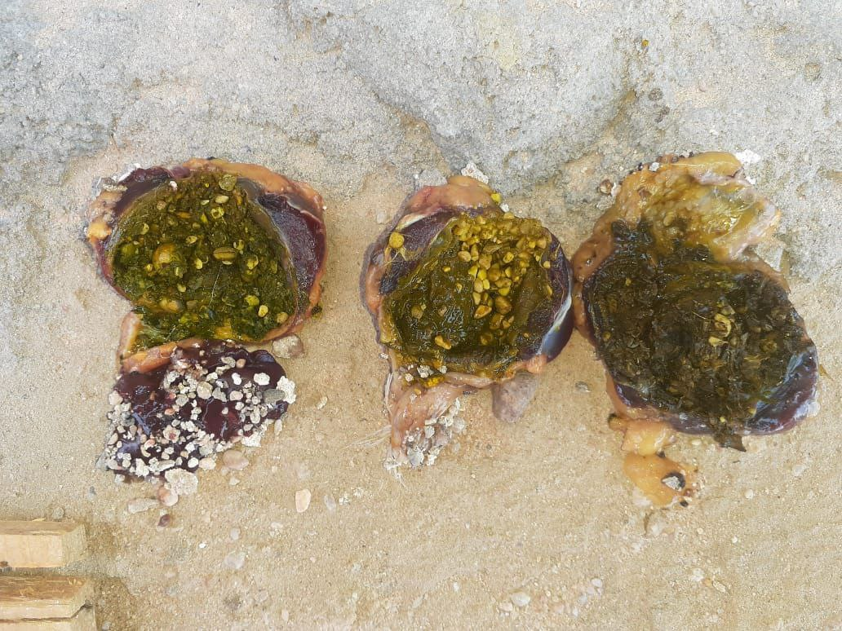
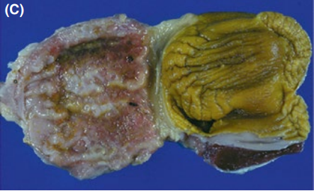
Mycotoxicosis
Observe the proventriculus for any macroscopic lesions or abnormalities, such as discoloration, hemorrhages, erosions, or ulcers.
The gizzard for any macroscopic lesions, such as thickening of the lining, erosions, ulcers, or changes in color or texture.

Slide 9
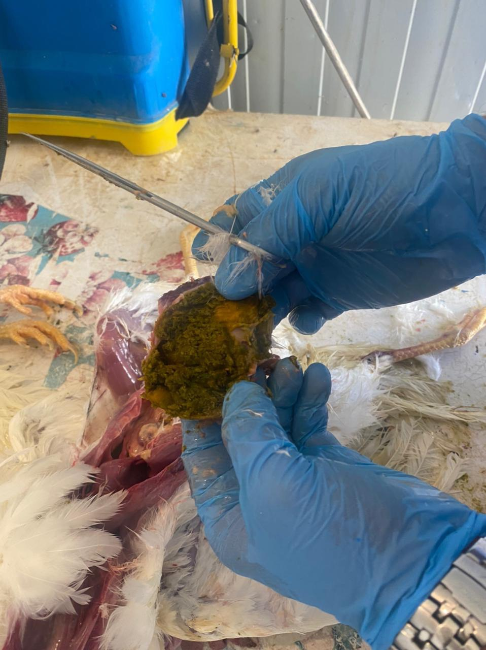
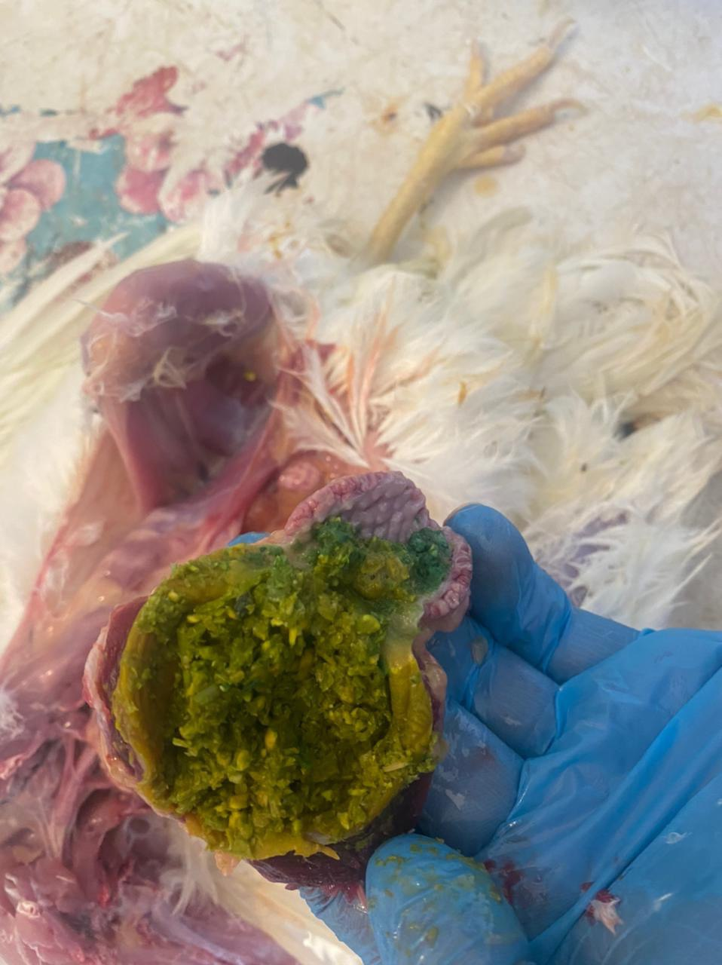
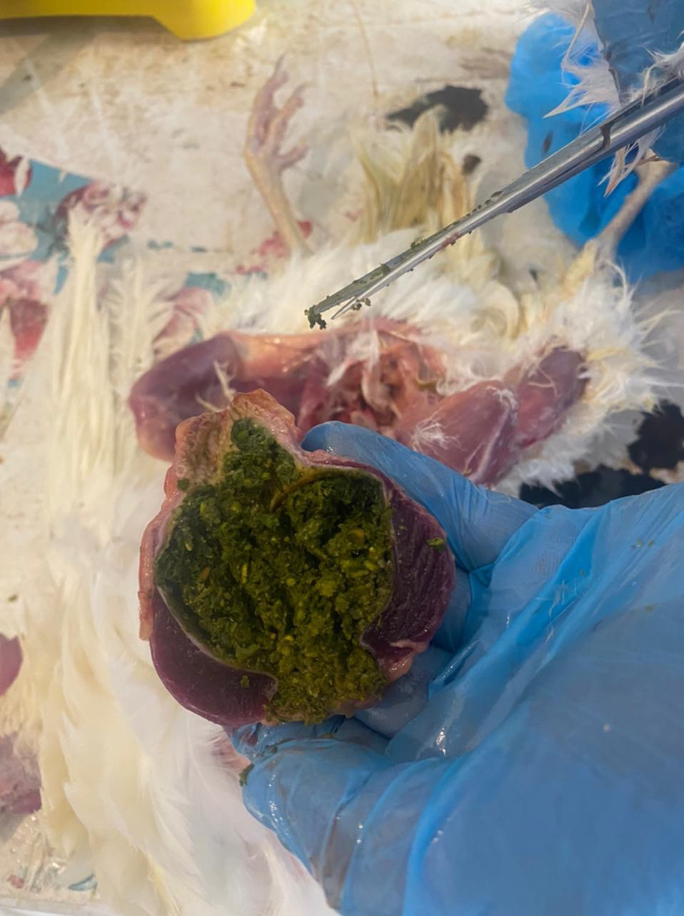
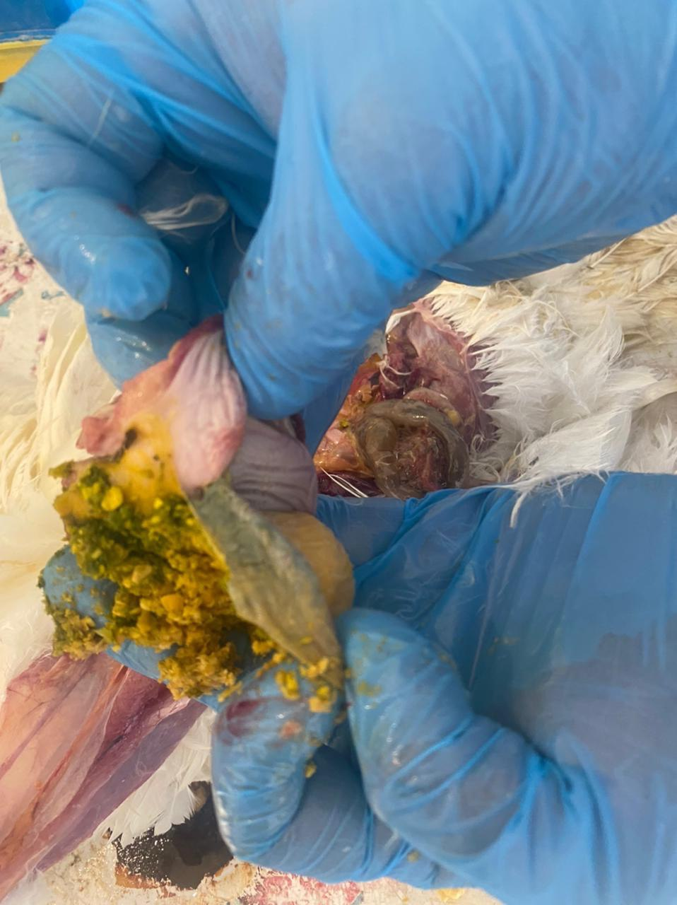
Mycotoxicosis
The proventriculus and gizzard are thickening of the lining, erosions, ulcers, changes in color(blackish discoloration).

Slide 10
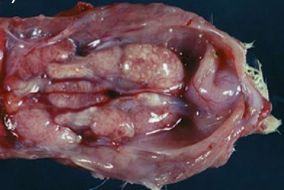
Mycotoxicosis
The kidneys for any macroscopic lesions or abnormalities, such as discoloration, enlargement, hemorrhages.

Slide 11
Fatty liver and kidney syndrome
chickens worldwide, including commercial layers and broiler breeders. FLKS is associated with high‐energy diets along with restricted exercise and is most common during hot weather.

Slide 12
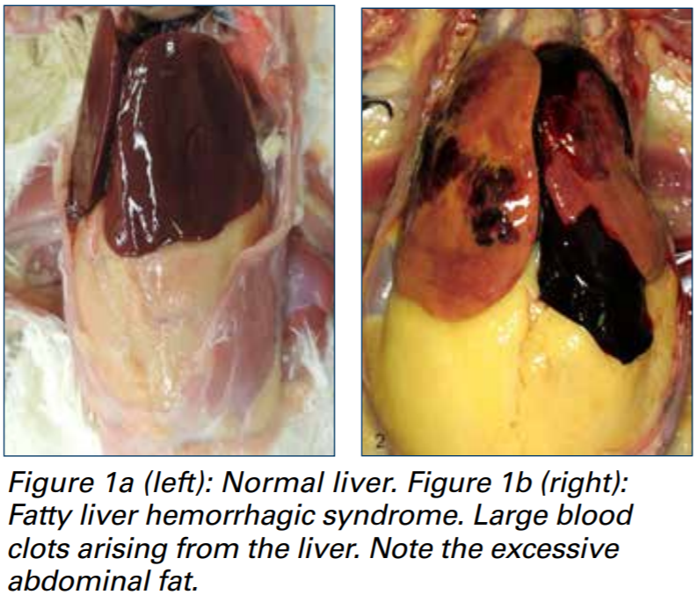
Fatty liver and kidney syndrome

Slide 13
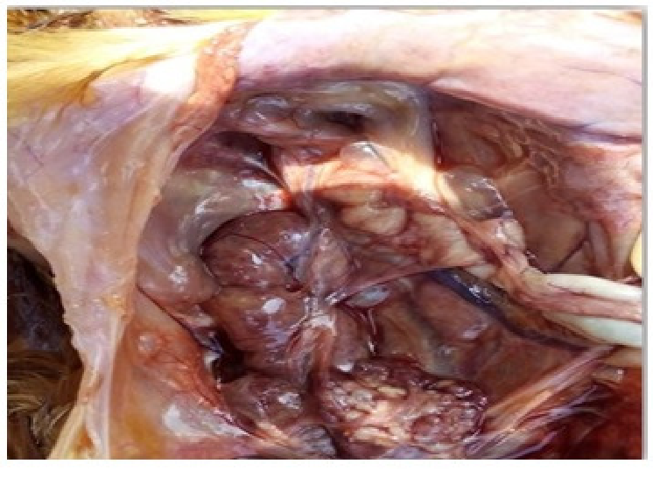
Fatty liver and kidney syndrome
During postmortem examination, the kidneys may appear enlarged, pale, and have a greasy appearance due to the accumulation of fat.
The fat deposition may be diffuse or focal within the renal parenchyma.

Slide 14
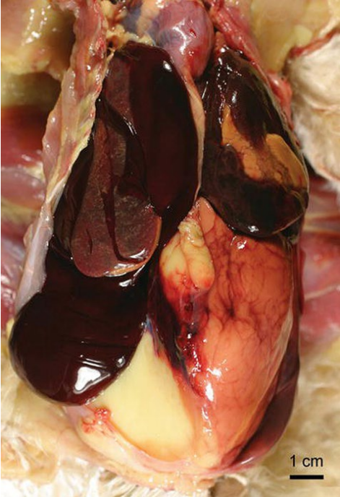
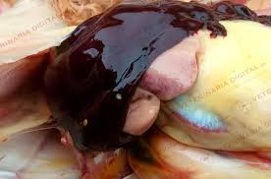
Fatty liver and kidney syndrome
Fatty liver–hemorrhagic syndrome. A large blood clot is molded over the left lobe of the liver. Note the excess abdominal fat.

Slide 15
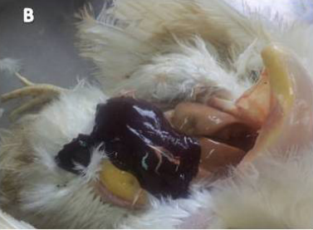
Fatty liver and kidney syndrome
A large amount of blood clots (hematoma) was also noticed in the abdominal cavity. Large amounts of fat deposits were also observed in the abdominal cavity.

